Slide 1
Making this resource work for you
Prior to teaching this lesson, please refer to the ‘Unit Overview and Planning Document’.
Further guidance on planning Science Mastery lessons can be found in the detailed planning guidance document.
Refer to the ‘notes’ section on each slide for useful information, including suggested expositions, pedagogical content knowledge, suggested questions, answers and more. Consider using presenter mode so you can see this guidance throughout the lesson.
The introduction slides can be adapted to suit your teaching style and the needs of your class.
Before the lesson, adapt the fix-it slide to address any misconceptions identified in the previous lesson’s exit ticket.
Choose from the suggested activities to suit your class. The intention is not that you complete all of these, but that you select those which ones are most appropriate for your students. It may be appropriate to further adapt activities for your students.
These lessons are designed to occupy approximately 1 hour. To adapt for a shorter or longer lesson duration we advise you to adapt the activity section accordingly.
Please consider using the final slide to send feedback about this lesson or examples of PowerPoints that you have adapted to our design team. Your feedback is used to improve Science Mastery for all of our teachers and students. We appreciate all suggestions and comments.
Thank you for reading!
The Science Mastery Team

Slide 2
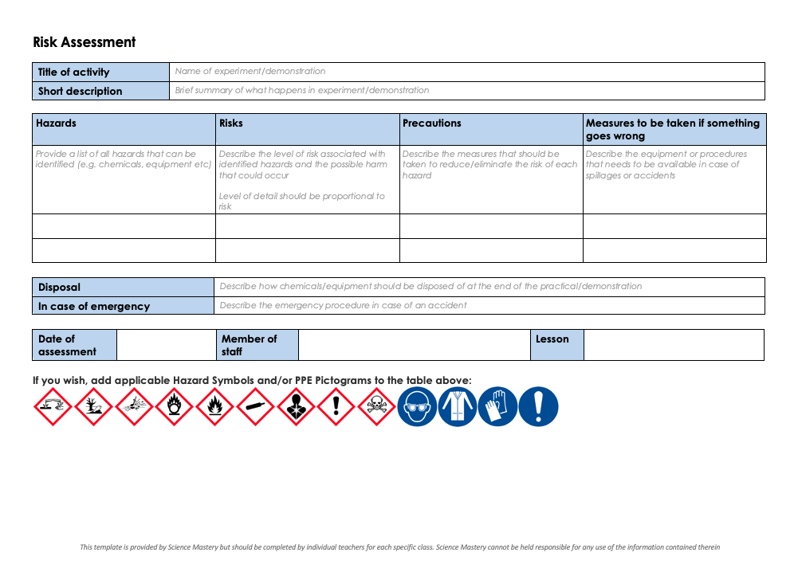
Practical Activity
This lesson contains a practical activity (either a whole class activity or a demonstration)
A risk assessment must be completed for this practical
The template risk assessment can be found here.
The risk assessment should be specific to the class involved and written only by the teaching member of staff
The risk assessment should refer to the current CLEAPSS Hazcards for all chemicals used in the practical for safety and disposal notes.
A list of chemicals used can be found in the Practical Guide
It is good practice for students to wear safety spectacles during all class practicals and demonstrations
Thank you for reading!
The Science Mastery Team

Slide 3
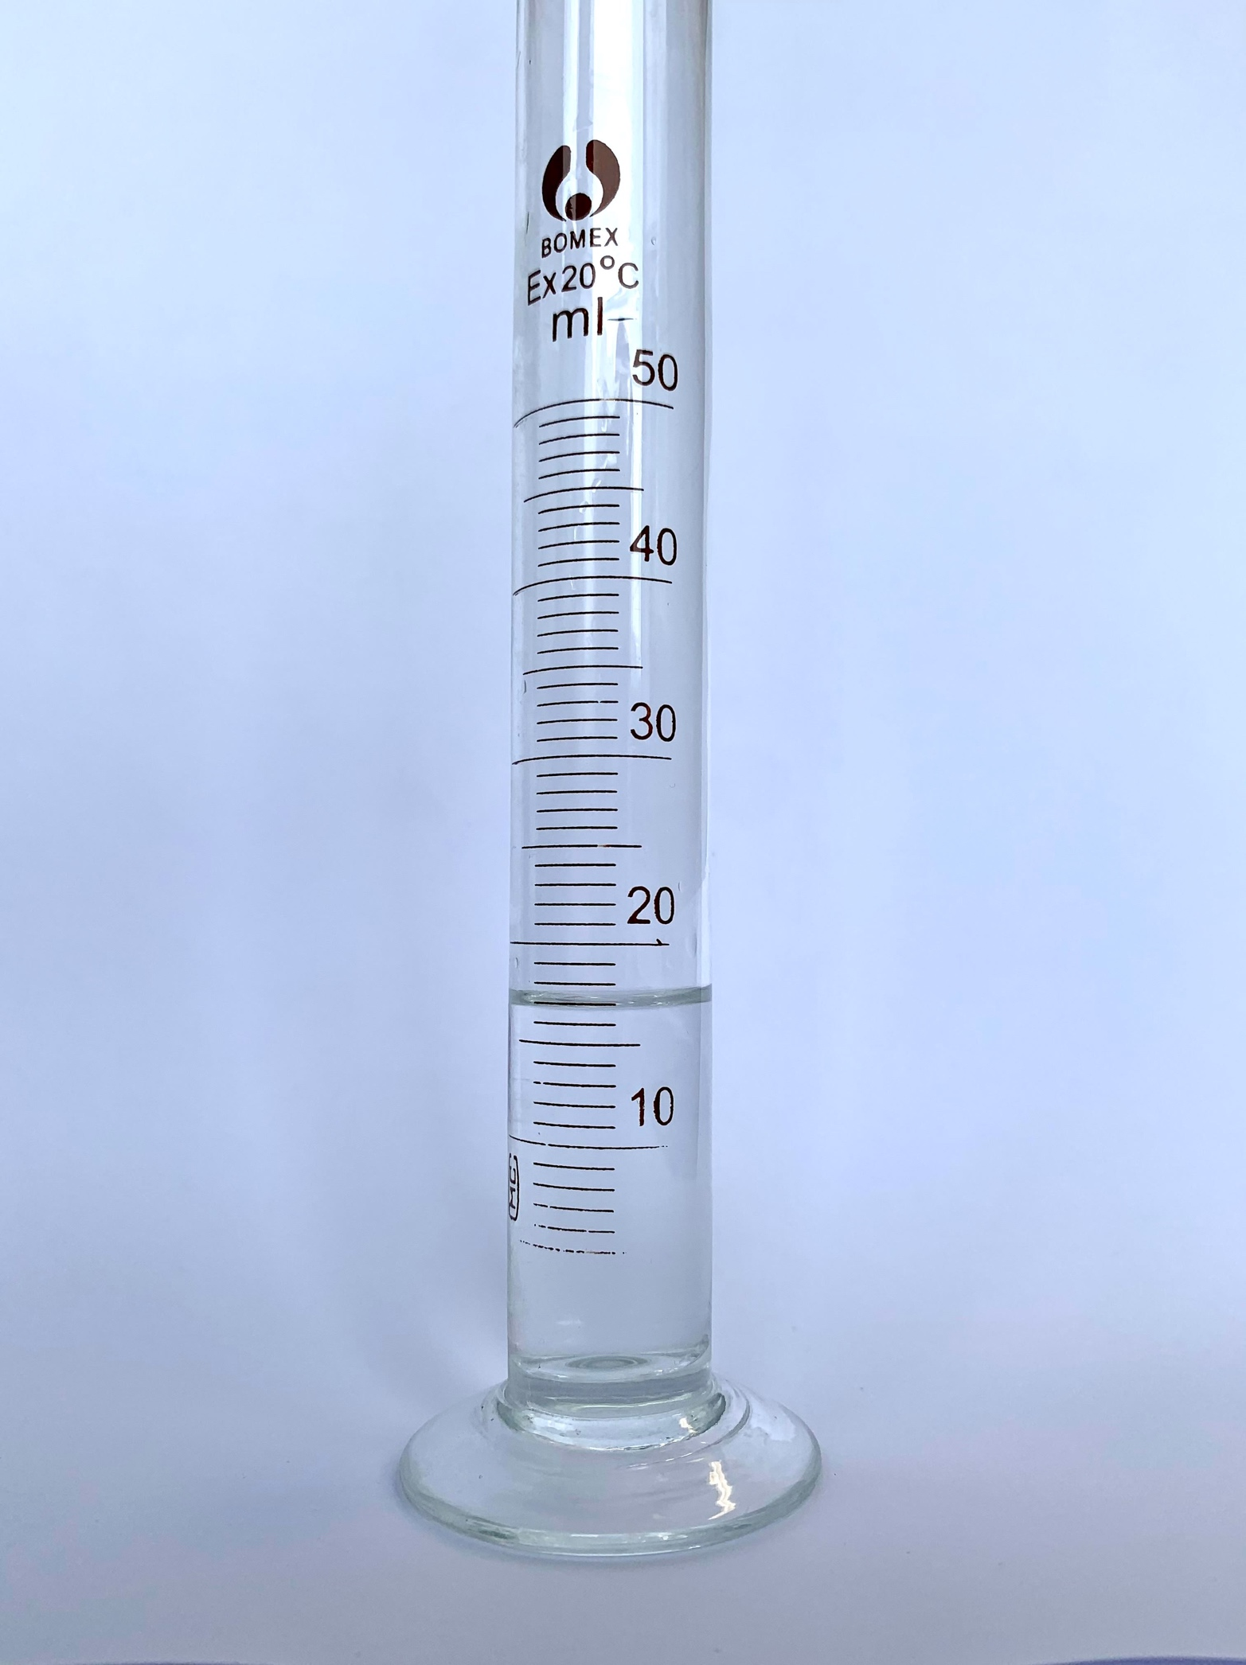
Measuring Density
Answer the questions below.
Define density.
State the formula to calculate the volume of a cube.
Which state of matter has the lowest density?
State the volume shown in this image.
Convert this volume into litres.
Mass per unit volume
$$V=lbh$$
Gas
17 mL
0.017 L
Notes:
Big idea: Energy is conserved
Foundation: Which state(s) of matter have a fixed volume?
Stretch: Explain why water as a solid and liquid is the exception to the rule about density of solids and liquids.
Answers:
Foundation: Solids and liquids
Stretch: Generally substances in solid form are more dense than their liquid form, but solid ice is less dense than liquid water.

Slide 4
Measuring Density
Do Now:
Define density.
State the formula to calculate the volume of a cube.
Which state of matter has the lowest density?
State the volume shown in this image.
Convert this volume into litres.
Drill:
State the formula to calculate area of a circle.
Calculate the area of one end of this cylinder.
Calculate the volume of this cylinder.
Radius = 2 cm
10 cm
Notes:
Drill answers
A = $πr^{2}$
A = 12.57 cm²
V = 125.70 cm³

Slide 5
Measuring Density
Read Now:
Density is the mass per unit volume, calculated using the mass of a substance divided by its volume. For regularly shaped solids, such as cubes, cuboids and cylinders, we can use mathematical formula to calculate their volumes. For irregularly shaped solids we must use a different method, as these formulae do not apply. We can use a piece of equipment called a Eureka can to measure how much liquid is displaced when the object is placed into it. You can think about this like when you get into the bath and the water rises. If the bath was full to the top and you got into it, the volume of water that spilled out of the bath would be equal to your volume.
Define density.
Describe how to calculate the volume of a regularly shaped solid.
Give an example of a regularly shaped solid.
Name the piece of equipment that can be used to measure the volume of liquid displaced by an irregularly shaped solid.
This paragraph describes how to measure the volume of different solids.
How could you measure the volume of a liquid?

Slide 6
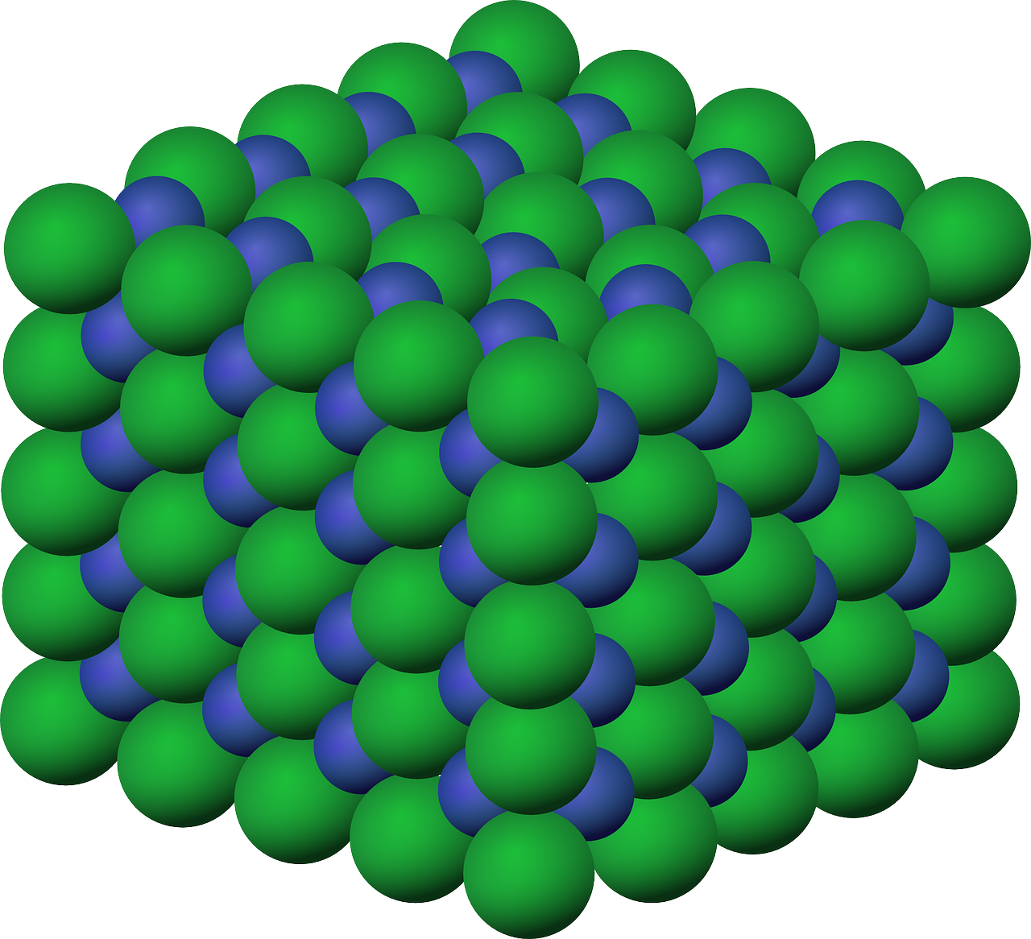
P4.1.3
14/03/2024
Measuring Density
P4.1.1 Prior Knowledge Review
P4.1.2 Density
P4.1.3 Measuring Density
P4.1.4 Gas Pressure
P4.1.5 Taking it Further: Pressure
P4.1.6 Taking it Further: Pressure in Fluids
Notes:
Big Idea: Energy is Conserved.
In the previous lesson, students reviewed the idea of density. In this lesson they will carry out the required practical to determine the densities of regular and irregular solids, and liquids.
Suggested Hook:
We often talk about how to calculate the density of different solids.
How might we calculate the density of a liquid? How could we check our calculations using a density column?

Slide 7

Following this lesson, students will be able to:
Describe how to measure density of an irregularly shaped solid
Measure volume accurately
Compare the methods for measuring the densities of an irregular and a regularly shaped solid
Key Words:
density
mass
volume
regular
irregular
displacement
Eureka can
Notes:
Guidance:
See unit overview document and planning guidance to see how these objectives are typically assessed at GCSE, including examples of what students should be able to do following this lesson.
Planning for different needs:
The learning objectives given on this slide are suggested based on the most common requirements for exams, however they can be adapted based on the needs of different classes.
For best practice, the unit preparation booklet should be used to determine the appropriate focus of lessons within the unit.
While it is not possible to explicitly split content into levelled grades, we recommend that lesson objectives can be classified as critical, core or stretch.
Critical: the content or skill is essential for all students to be able to progress.
Core: the content or skill is important for students to progress, but other opportunities may be available to revisit it.
Stretch: the content or skill may not be essential for all students but is important for students aiming for the highest grades.
Key skill: this is a crucial skill being developed in this unit as part of the skill mapping
P4.1.3 Lesson Objectives:
Critical: Describe how to measure density of an irregularly shaped solid
Key skill: Measure volume accurately
Core: Compare the methods for measuring the densities of an irregular and a regularly shaped solid

Slide 8
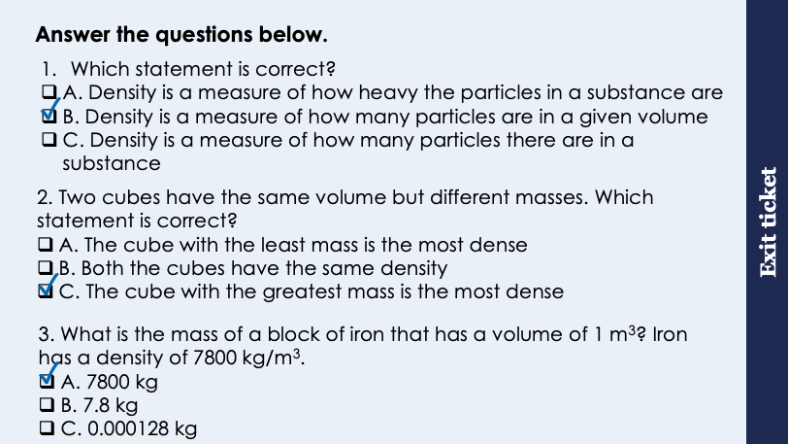
This is the fix-it portion of the lesson
The fix-it is an opportunity to respond to gaps in knowledge, especially those identified by the previous lesson’s exit ticket.
The teacher should customise this slide as needed, to facilitate
reteach, explanation, demonstration or modelling of ideas and concepts that students have not yet grasped or have misunderstood.
practise answering specific questions or of key skills.
redrafting or improving previous work.
Notes:
Purpose: to spend time on any gaps identified in previous learning from exit ticket feedback.
Fix-it guidance from previous exit ticket:
Q1. Answer: B
If students answer A, they have confused density with weight. If students answer C, they have confused density with mass. To fix-it, review the definitions of density, mass, volume and weight.
Q2. Answer: C
If students answer A or B, they are not clear on the relationship between mass, volume and density. To fix-it, use numbers to show students how two objects can have the same volume but different masses and then ask them to explain this in terms of the relationship between mass, volume and density.
Q3. Answer: A
If students answer B, they have made a mistake and assumed this mass needs to be converted. If students answer C, they have divided volume by density. To fix-it, give students further practice questions, mixing between calculating mass, volume and density.

Slide 9
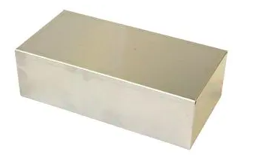
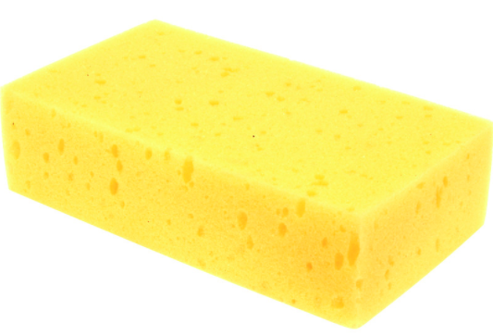
Measuring Density
What is the equation to calculate density?
What measurements would need to be taken to calculate density?
How would you take these measurements?
Notes:
Suggested points:
This should review the key points from last lesson.
Density = mass/volume
You would need to measure mass and volume of the object
Mass can be measured using a balance
Volume can be calculated using the correct formula (if it is a regularly shaped object). Irregularly shaped objects will be covered in a later slide.
Suggested guidance:
Talk tasks can be used in a variety of ways to suit the particular needs of the students you are teaching. Through exchanging views with others, students develop their understanding of the science beyond what could be achieved individually.
Science classrooms that successfully integrate talk have the following features:
Science talk is a regular feature of lessons and is woven into classroom activities.
Students are paired or grouped strategically by the teacher to ensure productive interaction. This might take into consideration the students’ proficiency of the English language, how encouraging they might be to peers and their attainment in the topic. It’s a good idea to consider these pairings in the class seating plan.
Students are encouraged and supported to talk, but are not forced to talk.
The teacher should take on the role of a facilitator, engaging with conversations where necessary and encouraging or steering the conversation where needed.
Students are encouraged to use the language they have to express their ideas (e.g., everyday language, imperfect English, native language), but also to incorporate science specific terminology where this is more accurate or has been taught.
6. Scientifically inaccurate ideas are not dismissed by the partner or teacher; open discussion and further investigation are relied on to help students construct ideas that support them to progress in their scientific understanding.
7. Guidelines for behaviour during talk tasks are explicit and frequently reviewed. Rules for students might be:
Listen carefully to your partner
Take turns talking.
Speak one at a time, without interrupting.
Politely agree or disagree and explain why.
Politely point out if your partner has used a scientific word incorrectly, if they have explained the science incorrectly, or if there is a more accurate way to describe something.
If confused, ask questions.
Stay focused on the discussion topic.
Respond to one another.

Slide 10
Measuring Mass
Tip: To measure the mass of a substance in a container, place the empty container on the balance before you tare the balance.
To measure the mass of an object we use a balance.
Method for measuring mass:
Make sure the balance is wiped clean.
Check that the balance is on a level surface.
Turn on the balance.
Ensure that the unit on the display is grams (g).
Tare the balance by pressing the ‘zero’ or ‘tare’ button.
Place the item you want to measure onto the balance and note the reading on the screen.
Why?
This ensures there isn’t any substance on the balance that would add to your measured mass.
Why?
This ensures the starting mass is 0.
Notes:
The following slides are a review of key skills covered in KS3, which you may want to review.
Suggested guidance:
For this part of the lesson give each group a balance that they can use, following along the instructions on the board. They can use any object to measure, such as a pencil case. To check that everyone is getting the correct result, you can supply everyone with a standard object, such as a beaker.

Slide 11
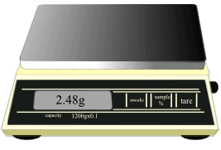
Answer the following question
A student turned on her balance to measure the mass of something.
When she looked at the screen, it read 2.48 g.
What should the student do next?
Press the ‘tare’ button to change the reading to 0 g.

Slide 12
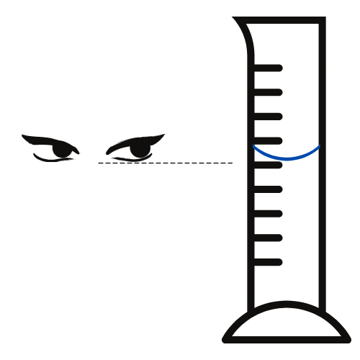


Reading liquid volumes accurately
1. Read from eye level
Bend down so your eyes are level with the water level
The meniscus
Liquids in long thin containers form a ‘U’ shaped meniscus.
2. Read the scale from the bottom of the meniscus
Look at the line on the scale which is closest to the bottom of the ‘U’ shape.
Notes:
Exposition type: Demonstration
Suggested teacher exposition:
Have all students pour the liquid they are measuring into a graduated cylinder.
Now we know we are using a graduated cylinder to measure volume in this case, as it gives the most precise measurements.
Look closely at the water in your graduated cylinder. Can you see how it makes a U shape? That is called the meniscus.
To read the volume of water most accurately, you should read from eye level, and also take the reading from the bottom of the meniscus.
Now, looking at your measured liquids, use this technique to read precisely the volume of water.

Slide 13
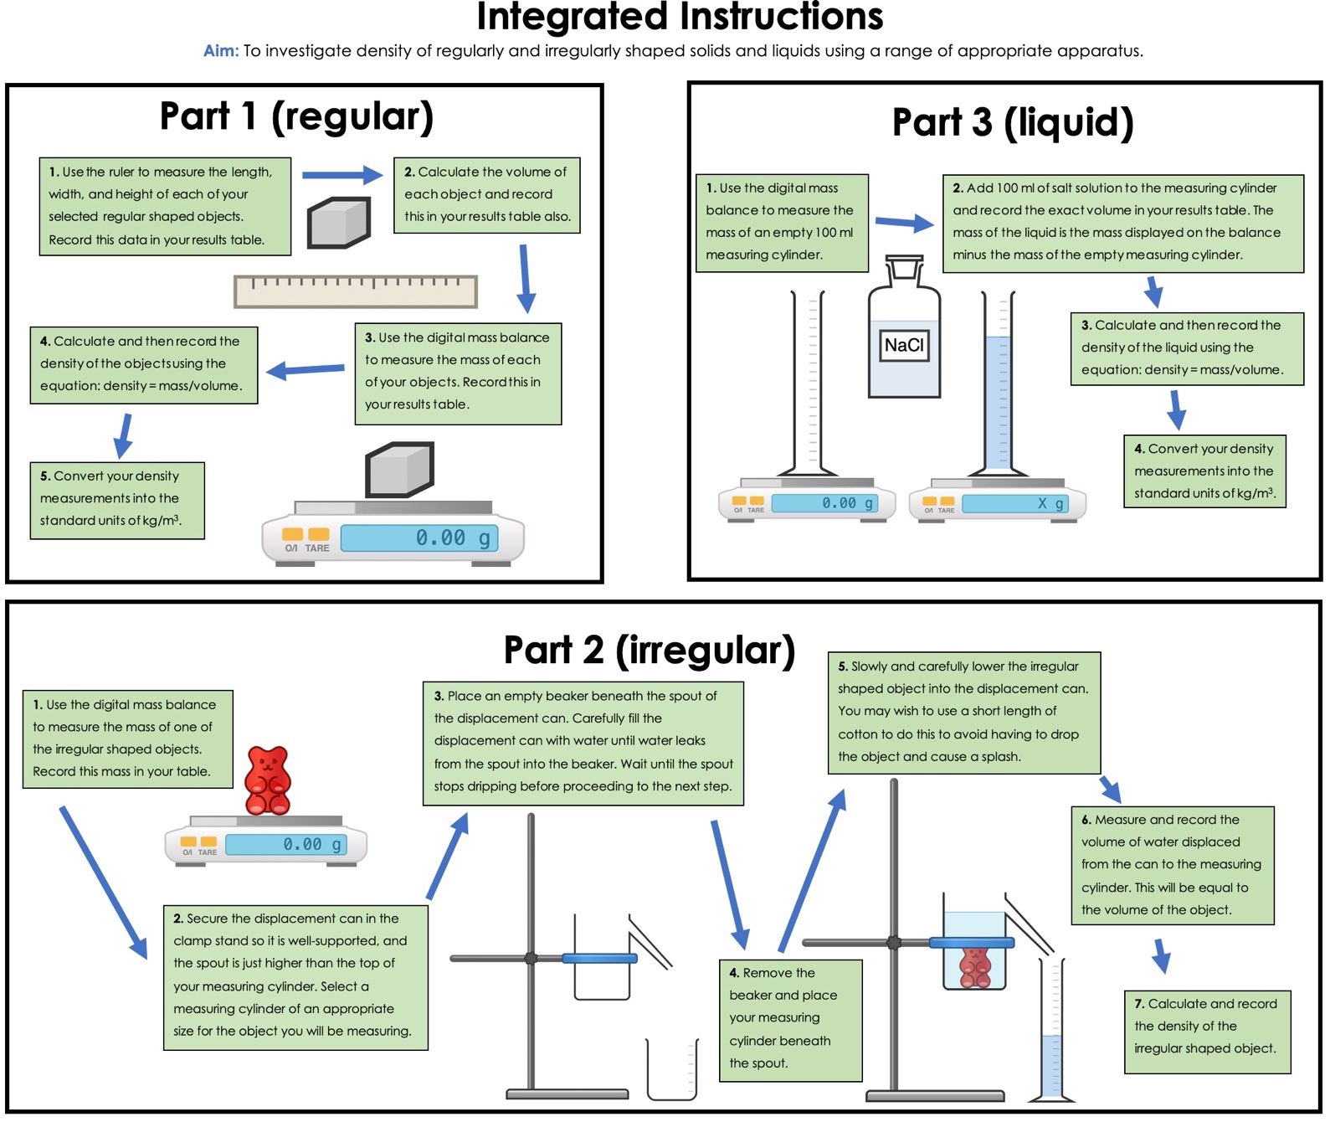
Using a displacement/eureka can
If an object has an irregular shape, the volume can be measured using a displacement can, or Eureka can.
Fill the displacement can (A) with water and wait until the water stops running out of the spout.
Place a graduated cylinder (B) under the spout.
Carefully lower the irregular object into the displacement can, collecting the displaced water in the graduated cylinder.
A
B
The displaced water in the cylinder occupies the same amount of space as the irregular object. The volume of water in the graduated cylinder is equal to the volume of the object!
Notes:
Suggested exposition:
An irregular shape is any shape that is not a perfect cube, cuboid, cylinder or sphere, so most objects in real life are irregular. Irregularly shaped objects do not have a uniform length, breadth or width so the mathematical formulae do not apply.
Demonstration
This should be demonstrated by the teacher as this slide is presented so that students can see the steps in action.
Points to include in the exposition:
1. Make sure the displacement can is on a level surface
2. Ensure the water sops dripping from the spout before placing the graduated cylinder underneath
3. When lowering the object into the water, be careful not to include the volume of your fingers! Keep them above the surface of the water.

Slide 14




Which statements do you agree with?
The displaced volume of water is equal to the volume of an object
The displacement method only works for irregularly shaped solids
Mass is measured using a balance
Density = mass x volume
Notes:
Suggested points:
Blue: incorrect. This method could also be used for regularly shaped solids, it is just easier to use calculations.
Yellow: correct.
Green: correct.
Pink: incorrect. Density = mass/volume
Suggested guidance:
Talk tasks can be used in a variety of ways to suit the particular needs of the students you are teaching. Through exchanging views with others, students develop their understanding of the science beyond what could be achieved individually.
Science classrooms that successfully integrate talk have the following features:
Science talk is a regular feature of lessons and is woven into classroom activities.
Students are paired or grouped strategically by the teacher to ensure productive interaction. This might take into consideration the students’ proficiency of the English language, how encouraging they might be to peers and their attainment in the topic. It’s a good idea to consider these pairings in the class seating plan.
Students are encouraged and supported to talk, but are not forced to talk.
The teacher should take on the role of a facilitator, engaging with conversations where necessary and encouraging or steering the conversation where needed.
Students are encouraged to use the language they have to express their ideas (e.g., everyday language, imperfect English, native language), but also to incorporate science specific terminology where this is more accurate or has been taught.
6. Scientifically inaccurate ideas are not dismissed by the partner or teacher; open discussion and further investigation are relied on to help students construct ideas that support them to progress in their scientific understanding.
7. Guidelines for behaviour during talk tasks are explicit and frequently reviewed. Rules for students might be:
Listen carefully to your partner
Take turns talking.
Speak one at a time, without interrupting.
Politely agree or disagree and explain why.
Politely point out if your partner has used a scientific word incorrectly, if they have explained the science incorrectly, or if there is a more accurate way to describe something.
If confused, ask questions.
Stay focused on the discussion topic.
Respond to one another.

Slide 15
Drill
State the equation that links density, mass and volume.
Name the piece of apparatus used to measure mass.
Describe how to calculate the volume of a regularly shaped solid.
Describe how a displacement/eureka can is used to measure the volume of an irregularly shaped solid.
List any units that could be used to measure mass.
List any units that could be used to measure volume.
Describe how to read the measurement of a liquid.
Notes:
Purpose: This is a knowledge drill. The purpose of this is to check that the critical knowledge is secure before pupils move onto independent practice.
Suggested guidance: There are a range of ways this could be done depending on time and ability range of the class:
Mini whiteboards
As full sentences in exercise books
As short answers in exercise books
In the pupil workbook
As pair talk
As cold call

Slide 16
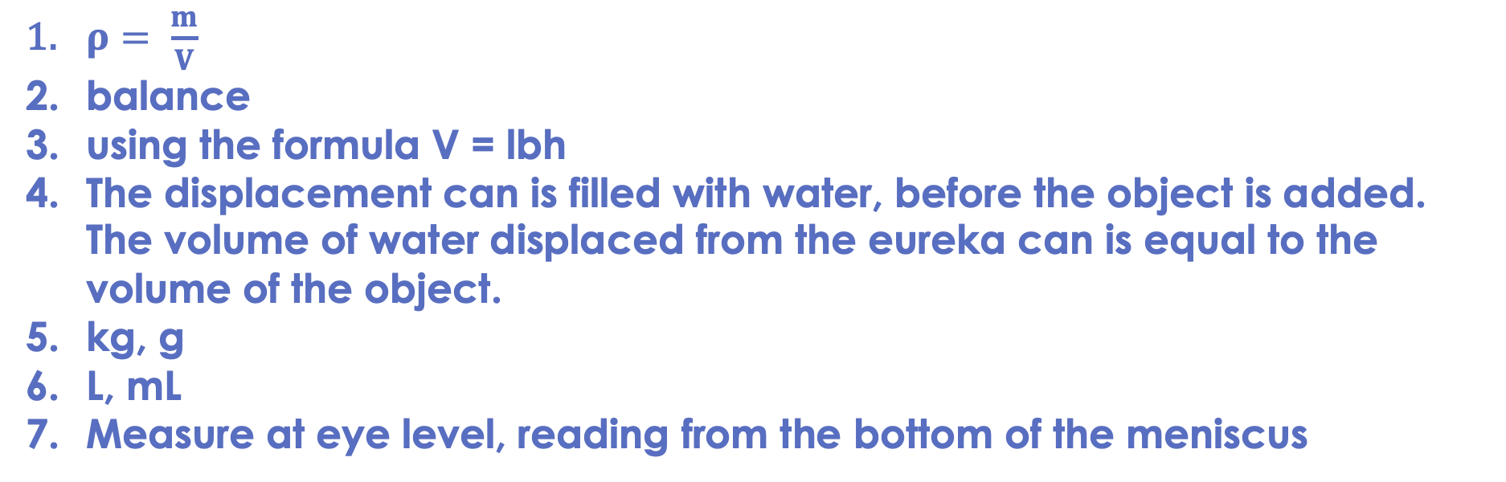
Drill answers
$ρ= \frac{m}{V}$
balance
using the formula V = lbh
The displacement can is filled with water, before the object is added. The volume of water displaced from the eureka can is equal to the volume of the object.
kg, g
L, mL
Measure at eye level, reading from the bottom of the meniscus
Notes:
Purpose: This is a knowledge drill. The purpose of this is to check that the critical knowledge is secure before pupils move onto independent practice.
Suggested guidance: There are a range of ways this could be done depending on time and ability range of the class:
Mini whiteboards
As full sentences in exercise books
As short answers in exercise books
In the pupil workbook
As pair talk
As cold call

Slide 17
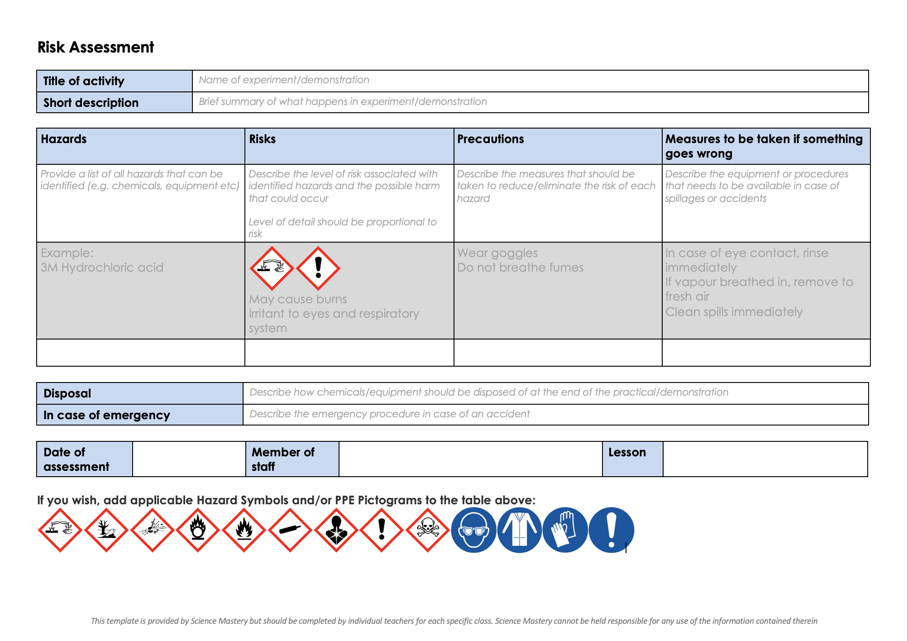
Risk Assessment
A risk assessment must be completed for this practical
The template risk assessment can be found here.

Slide 18
Measuring the density of regularly shaped solids
Regular shaped object | Length (cm) | Width (cm) | Height (cm) | Volume (cm³) | Mass (g) | Density (g/cm³) | Density (kg/m³)
Notes:
Carry out the required practical, using the integrated instructions. You may want to model each method for students first.

Slide 19
Measuring the density of irregularly shaped solids
Irregular shaped object | Volume (cm³) | Mass (g) | Density (g/cm³) | Density (kg/m³)

Slide 20
Measuring the density of liquids
Liquid | Volume (cm³) | Mass (g) | Density (g/cm³) | Density (kg/m³)

Slide 21
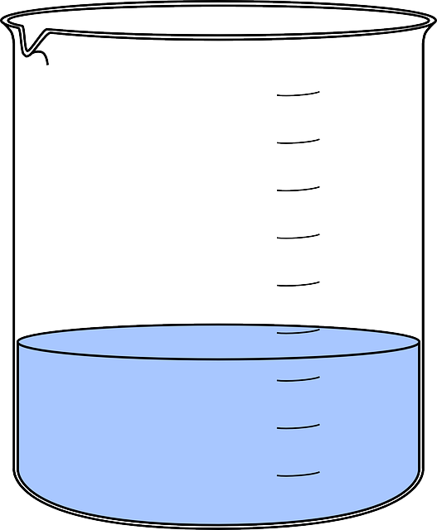
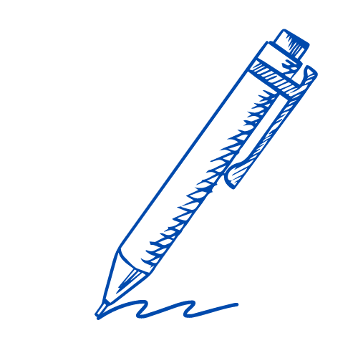
I: Describe: to recall facts, events or processes in an accurate way
Example question:
Describe how to determine the density of a liquid.
To ‘describe’, your answer should:
Use bullet points.
Include each step of the process in a logical order.
Use keywords throughout the answer
Stay focused on the question.
Model answer:
Measure the volume using a measuring cylinder
Measure the mass of the empty measuring cylinder using a mass balance
Measure the mass of the measuring cylinder when the liquid is in it and subtract the mass of the empty cylinder
Use the equation density = mass/volume
Notes:
This slide models the process of answering a describe question.
Firstly, students are presented with a generic describe question, along with a model answer. Students are also given some simple guidance to follow for producing their own describe answer.
The generic question and answer should be used by the teacher to remind students of
the key features of a great answer
how to structure their answer
why the model answer is a good example
Following this, students will be required to apply this process to answer their own describe question, which will appear in place of the generic questions. This describe question will be specific to the topic students are learning about in the lesson. Give students time to write their own answer to this, ensuring that they use the guidance provided. To further scaffold this task for students, it may be appropriate to:
pair students up to write an answer together
list for students the key words you would like them to include in the answer
provide a writing frame or ‘points to include’ for students
A model answer for this question will appear. Teachers should review the model answer with students by referencing the guidance in the green box. For example ‘we can see item 1 in the guidance is to use bullet points to keep your answer clear. Notice in the model answer here we have done just that’. Or ‘item 2 in the guidance here says that we should use scientific keywords in the answer. Has this been achieved in the model answer? Where can we see this?’.

Slide 22
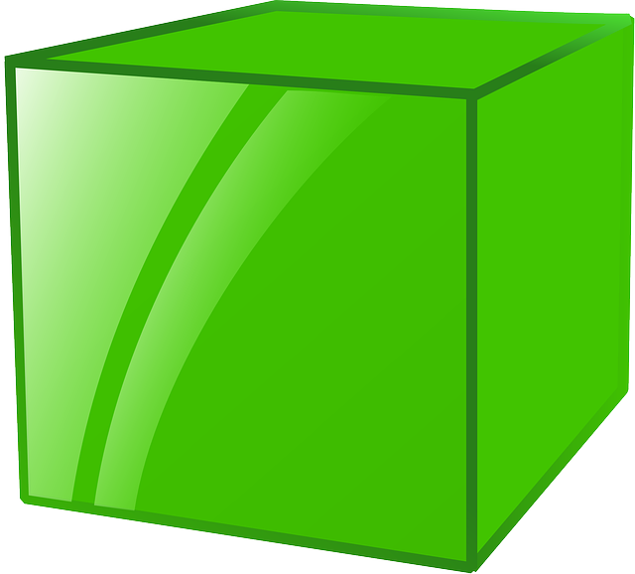
We: Describe: to recall facts, events or processes in an accurate way
Example question:
Describe how to determine the density of a regularly shaped object.
To ‘describe’, your answer should:
Use bullet points.
Include each step of the process in a logical order.
Use keywords throughout the answer
Stay focused on the question.
Model answer:
Measure the mass of the object using a mass balance
Calculate the volume using its dimensions (V=lbh)
Use the equation density = mass/volume
Notes:
This slide models the process of answering a describe question.
Firstly, students are presented with a generic describe question, along with a model answer. Students are also given some simple guidance to follow for producing their own describe answer.
The generic question and answer should be used by the teacher to remind students of
the key features of a great answer
how to structure their answer
why the model answer is a good example
Following this, students will be required to apply this process to answer their own describe question, which will appear in place of the generic questions. This describe question will be specific to the topic students are learning about in the lesson. Give students time to write their own answer to this, ensuring that they use the guidance provided. To further scaffold this task for students, it may be appropriate to:
pair students up to write an answer together
list for students the key words you would like them to include in the answer
provide a writing frame or ‘points to include’ for students
A model answer for this question will appear. Teachers should review the model answer with students by referencing the guidance in the green box. For example ‘we can see item 1 in the guidance is to use bullet points to keep your answer clear. Notice in the model answer here we have done just that’. Or ‘item 2 in the guidance here says that we should use scientific keywords in the answer. Has this been achieved in the model answer? Where can we see this?’.

Slide 23

You: Describe: to recall facts, events or processes in an accurate way
Example question:
Describe how to determine the density of an irregularly shaped object.
To ‘describe’, your answer should:
Use bullet points.
Include each step of the process in a logical order.
Use keywords throughout the answer
Stay focused on the question.
Model answer:
Measure the mass of the object using a mass balance
Part fill a measuring cylinder with water and place next to a displacement can or Eureka can
Add the object to the measuring cylinder and measure the volume of water displaced.
This is the volume of the object
Use the equation density = mass/volume
Notes:
This slide models the process of answering a describe question.
Firstly, students are presented with a generic describe question, along with a model answer. Students are also given some simple guidance to follow for producing their own describe answer.
The generic question and answer should be used by the teacher to remind students of
the key features of a great answer
how to structure their answer
why the model answer is a good example
Following this, students will be required to apply this process to answer their own describe question, which will appear in place of the generic questions. This describe question will be specific to the topic students are learning about in the lesson. Give students time to write their own answer to this, ensuring that they use the guidance provided. To further scaffold this task for students, it may be appropriate to:
pair students up to write an answer together
list for students the key words you would like them to include in the answer
provide a writing frame or ‘points to include’ for students
A model answer for this question will appear. Teachers should review the model answer with students by referencing the guidance in the green box. For example ‘we can see item 1 in the guidance is to use bullet points to keep your answer clear. Notice in the model answer here we have done just that’. Or ‘item 2 in the guidance here says that we should use scientific keywords in the answer. Has this been achieved in the model answer? Where can we see this?’.

Slide 24
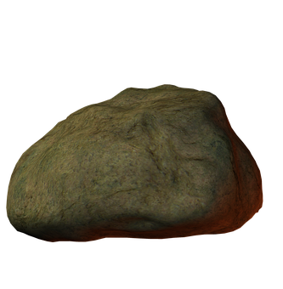
Describe a method to calculate the density of this rock
use a balance to measure the mass of the rock
then
part fill a measuring cylinder with water
measure initial volume
place object in water
measure final volume
volume of object = final volume − initial volume
or
fill a displacement / eureka can with water
water level with spout
place object in water
collect displaced water
measuring cylinder used to determine volume of displaced water
then
use density = mass/volume to determine the density

Slide 25
Answer the questions below.
Which measurement is taken using a displacement or eureka can?
A. Density
B. Mass
C. Volume
✓
2. Which statement is correct?
A. The volume of water displaced by an irregularly shaped object is the same as the volume of the object
B. The volume of water left in the eureka can is the same as the volume of the object
C. Using the volume of water displaced by an object only works for irregularly shaped objects
✓
3. What is the density of an object with mass 5 g that displaced 25 cm³ of water?
A. 125 g/cm³
B. 0.2 g/cm³
C. 5 g/cm³
✓
Notes:
Q1. Answer: C
If students answer A or B, they are not clear on the function of a displacement or eureka can. To fix-it, review the purpose of a balance and the displacement can in the method to determine density.
Q2. Answer: A
If students answer B, they have confused the idea of the displaced liquid. To fix-it, review the process of using the displacement can. If students answer C, they have assumed that this method only works for irregularly shaped solids. To fix-it, explain to students that this method could also be used for regularly shaped solids but it is simpler to use mathematical formulae.
Q3. Answer: B
If students answer A, they have multiplied mass by volume. If students answer C, they have divided volume by mass. To fix-it, give students further practice questions, mixing between calculating mass, volume and density.

Slide 26
Lesson P4.1.3
What was good about this lesson? | What can we do to improve this lesson?
Send us your feedback by clicking this link. Thank you!

